Slide 1
Capgemini Financial Services
Independent Test Engineering and Monitoring Solutions
ISTQB Foundation Level
Chapter- 3 Static techniques
Notes:
Add a content or an objective slide in the beginning of the presentation. The main objective is to;
Understand the defect lifecycle, be able to write defect reports effectively, to be able to use a defect tracking tool effectively

Slide 2

Agenda
Static and Dynamic techniques.
Review process
Static analysis by tools

Slide 3
Static and Dynamic techniques.
Static
Dynamic
Reviews
etc.
Behavioural
Inspection
Static Analysis
Walkthroughs
Structural
Non-functional
Functional
Desk-checking
etc.
etc.
Usability
Equivalence
Partitioning
Control
Flow
Data
Flow
Performance
etc.
Boundary
Value Analysis
etc.
Statement
Symbolic
Execution
Cause-Effect Graphing
Branch/Decision
Arcs
Random
Definition
-Use
Branch Condition
LCSAJ
Branch Condition
Combination
State Transition

Slide 4
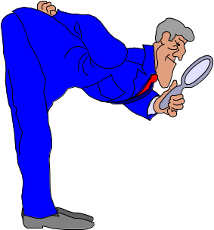
Reviews
Review

Slide 5
Review Definition
Reviews
IEEE Standard Glossary of SE Terminology:
  A process or meeting during which a work product, or a set of work products, is presented to project personnel, managers, users, customers, or other interested parties for comment or approval.
  Types include code review, requirements review etc.

Slide 6

Reviews
Review:
    Presentation of each SW Component to the Group
    in each Development Phase
    Discussion and Coordination with other components
    Goal:
    Clarification and Accept/Reject Decision
Notes:
Reviews take the form of presentations followed by discussions during open meetings with all developers involved in the project. Each software component is presented to the group in each of the phases. The goal is clarification, enhancement and an accept or possibly reject decision.
Formal Inspection goes through documents and code thoroughly and in a well planned manner. The goal is defect detection and ultimately defect prevention.

Slide 7
Reviews
Reviews are applied at various points during software development and serve to uncover errors and defects that can then be removed.
Software reviews are a “filter” for the software engineering process.
Software review “purify" the software engineering activities that we have called analysis, design and coding.

Slide 8
Reviews
A review – any review – is a way of using the diversity of a group of people to :
Point out needed improvements in the product of a single person or team.
Confirm those part of the product in which improvement is either not desired or not needed.
The main goal is to identify defects within the stage or phase of the project where they originate,rather than in later test stages; this is referred to as “stage containment.”

Slide 9
Roles and responsibilities
A typical formal review will include the roles below:
Manager: decides on the execution of reviews, allocates time in project schedules and determines if the review objectives have been met.
Moderator: the person who leads the review of the document or set of documents, including planning the review, running the meeting, and follow-up after the meeting. If necessary, the moderator may mediate between the various points of view and is often the person upon whom the success of the review rests.

Slide 10
Roles and responsibilities
Author: the writer or person with chief responsibility for the document(s) to be reviewed.
Reviewers: individuals with a specific technical or business background (also called checkers or inspectors) who, after the necessary preparation, identify and describe findings (e.g.defects) in the product under review. Reviewers should be chosen to represent different perspectives and roles in the review process and they take part in any review meetings.
Scribe (or recorder): documents all the issues, problems and open points that were identified during the meeting.

Slide 11
The Players
review
leader
standards (SQA)
producer
recorder
reviewer
user rep

Slide 12
Conducting the Review
1.
be prepared—evaluate
product before the review
2.
review the product, not
the producer
3.
keep your tone mild, ask
questions instead of
making accusations
4.
stick to the review agenda
5.
raise issues, don't resolve them
6.
avoid discussions of style—stick to technical
correctness
7.
schedule reviews as project tasks
8.
record and report all review results

Slide 13
What Can You Review?
Anything written down on paper!
• Code reviews are just a starting point
Examples of things that can and should be reviewed:
• Requirements
– Catching problems here can save huge amounts of time/money later
• Design
• Test plans
• Test results
• Implementation
• Process plans
• …

Slide 14
Life Cycle Applications
Life Cycle Applications
Types and methods of reviews will normally be specified in the Software Development Plan or Program Management Plan. Some are dictated by a contract.
Reviews consist of three parts:
  Planning
  Review Conduct
  Post-Review
All three are very important for a successful review

Slide 15
Planning Phase
Planning Phase
Stating purpose of the review
Selecting and arranging participants
Distribution of review material
Provide ahead of time
Setting physical location
Preparing an agenda

Slide 16
Conduct Phase
Conduct Phase
Keeping to the agenda
Remember, the purpose of the review is to identify the problems and assign action for their resolution, not fixing the problems themselves
Review leader/moderator must maintain control
Scribe/recorder puts proceedings into written form

Slide 17
Post-Review Phase
Post-Review Phase
  Depends on the actions required
Progress on AIs may be reported at the next review
Unsatisfactory results of a review may require another one

Slide 18
Reviews
Types of review
Informal review
Walkthrough
Technical review
Inspection

Slide 19
Informal review
Key characteristics:
No formal process;
There may be pair programming or a technical lead reviewing designs and code;
optionally may be documented;
May vary in usefulness depending on the reviewer;
Main purpose: inexpensive way to get some benefit.

Slide 20
Walkthrough
Key characteristics:
Meeting led by author;
Scenarios, dry runs, peer group;
Optionally a pre-meeting preparation of reviewers, review report, list of findings and scribe
(who is not the author)
May vary in practice from quite informal to very formal;
Main purposes: learning, gaining understanding, defect finding.

Slide 21
Technical review
Key characteristics:
Documented, defined defect-detection process that includes peers and technical experts;
May be performed as a peer review without management participation;
Ideally led by trained moderator (not the author);
Pre-meeting preparation;
Optionally the use of checklists, review report, list of findings and management participation;
May vary in practice from quite informal to very formal;
Main purposes: discuss, make decisions, evaluate alternatives, find defects, solve technical
problems and check conformance to specifications and standards.

Slide 22
Inspection
Key characteristics:
Led by trained moderator (not the author);
Usually peer examination;
Defined roles;
Formal process based on rules and checklists with entry and exit criteria;
Pre-meeting preparation;
Inspection report, list of findings;
Formal follow-up process;
Optionally, process improvement and reader;
main purpose: find defects.

Slide 23
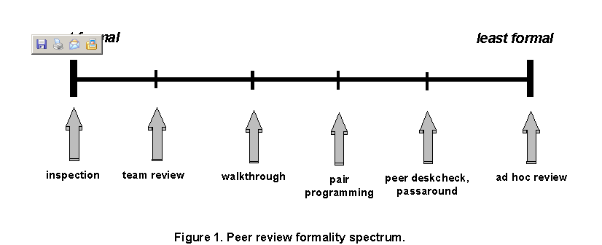
Review formality spectrum

Slide 24
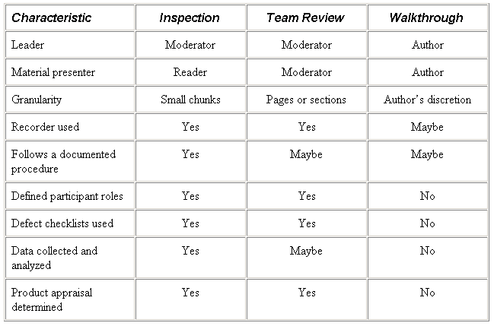
Comparison

Slide 25
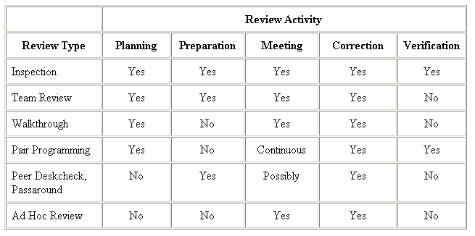
Review activity

Slide 26
Inspection - Objectives
Defect Detection
  Documents are checked for
  cleanness and consistency against rules
Defect Prevention
  Learning from defects found
  Suggesting improvements
On the Job Training
  Education in standards and rules
Benefits
Notes:
The first objective of inspection as it has been invented by Michael Fagan at IBM in 1976 is Defect Detection. It is performed before testing, and to complement testing. The aim is to identify and correct major defects in the document before releasing it from the current development phase.
Meanwhile the Inspection method has been further developed by others, in particular Tom Gilb. There the Defect Prevention Process is concerned with learning from the defects found, and suggesting ways of improving the processes to prevent them from re-occurring in the future. Team participants profit from the experience made during the inspection when producing their own work while the inspection process is improved on participant’s suggestions and according to changes in technology.
On the job training is a valuable benefit of a dynamic and open inspection process. It provides implicit integration and education of people which are new to the project. A basic set of process guidelines, checklists and rules is available for convenient entry into the project but at the same time it is open to easy modifications and additions of new ideas.

Slide 27
Inspection
Inspection Process
1. Planning 4. Meeting
2. Overview 5. Rework
3. Preparation 6. Follow-up

Slide 28
Inspection
1. Planning
• Schedules
• Participants
• Materials

Slide 29
Inspection
2. Overview
Objectives:
• Provide educational background to
understand materials
Description:
• Presentation by author of work to be
inspected

Slide 30
Inspection
3. Preparation
• Objectives -Prepare participants to identify
defects.
• Description -Individually study inspection
material.

Slide 31
Inspection
4. Inspection Meeting
1. Introduce meeting - moderator reminds people of the roles
2. Establish preparedness - moderator confirms inspectors
prepared
3. Review inspection checklist - confirms all items on check list studied
4. Read product and record defects - reader reads, inspectors
raise defects, discussion, recorder records the defects
5. Review the defect list - review the defect list for completeness
Make final decision - accept, verify rework, re-inspect

Slide 32
Static analysis by tools
The objective of static analysis is to find defects in software source code and software models. Static analysis is performed without actually executing the software being examined by the tool; dynamic testing does execute the software code.
Typical defects discovered by static analysis tools include:
referencing a variable with an undefined value;
inconsistent interface between modules and components;
variables that are never used;
unreachable (dead) code;
programming standards violations;
security vulnerabilities;
syntax violations of code and software models.

Slide 33
Thank You

